Slide 1
Regularization Techniques
Michael Gilbert

Slide 2
Books
Hands On Machine Learning with Scikit-Learn, Keras and Tensorflow, 3rd Edition
Introduction to Statistical Learning with Applications in Python (https://www.statlearning.com/),

Slide 3
Regularization
As we know, overfitting is a problem
Want to find a way to reduce the amount of variance or overfitting in our models
What can we do?
Why not add a penalty to the cost function to keep the weights smaller (constrain them) and not let any one weight dominate the regression.

Slide 4
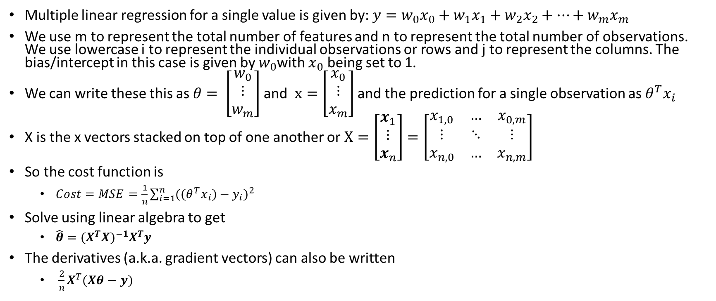
Linear Regression Review
Multiple linear regression for a single value is given by: $y=w_{0}x_{0}+w_{1}x_{1}+w_{2}x_{2}+…+w_{m}x_{m}$
We use m to represent the total number of features and n to represent the total number of observations. We use lowercase i to represent the individual observations or rows and j to represent the columns. The bias/intercept in this case is given by $w_{0}$with $x_{0}$ being set to 1.
We can write these this as $θ= \left[\begin{matrix}w_{0} \\ ⋮ \\ w_{m}\end{matrix}\right]$ and $x=\left[\begin{matrix}x_{0} \\ ⋮ \\ x_{m}\end{matrix}\right]$ and the prediction for a single observation as $θ^{T}x_{i}$
X is the x vectors stacked on top of one another or $X=\left[\begin{matrix}x_{1} \\ ⋮ \\ x_{n}\end{matrix}\right]=\left[\begin{matrix}x_{1,0} & … & x_{0,m} \\ ⋮ & ⋱ & ⋮ \\ x_{n,0} & … & x_{n,m}\end{matrix}\right]$
So the cost function is
$Cost=MSE=\frac{1}{n}\sum_{i=1}^{n}{{((θ^{T}x_{i})−y_{i})}^{2} }$
Solve using linear algebra to get
$\hat{θ}={(X^{T}X)}^{−1}X^{T}y$
The derivatives (a.k.a. gradient vectors) can also be written
$\frac{2}{n}X^{T}(Xθ−y)$

Slide 5
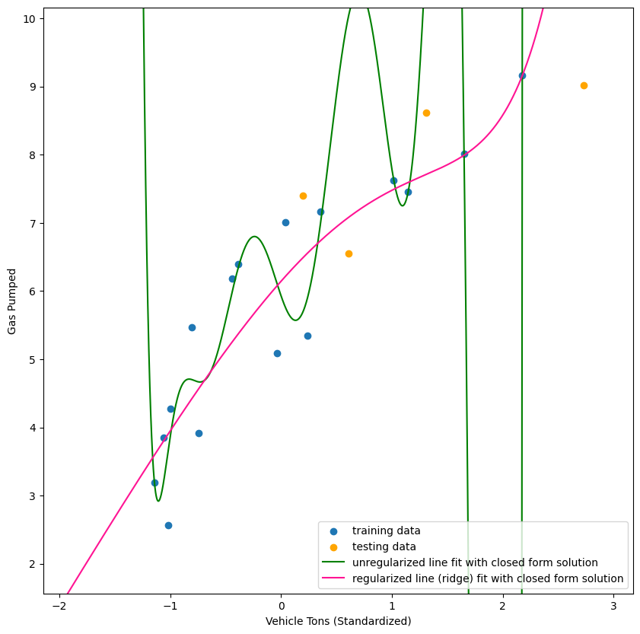
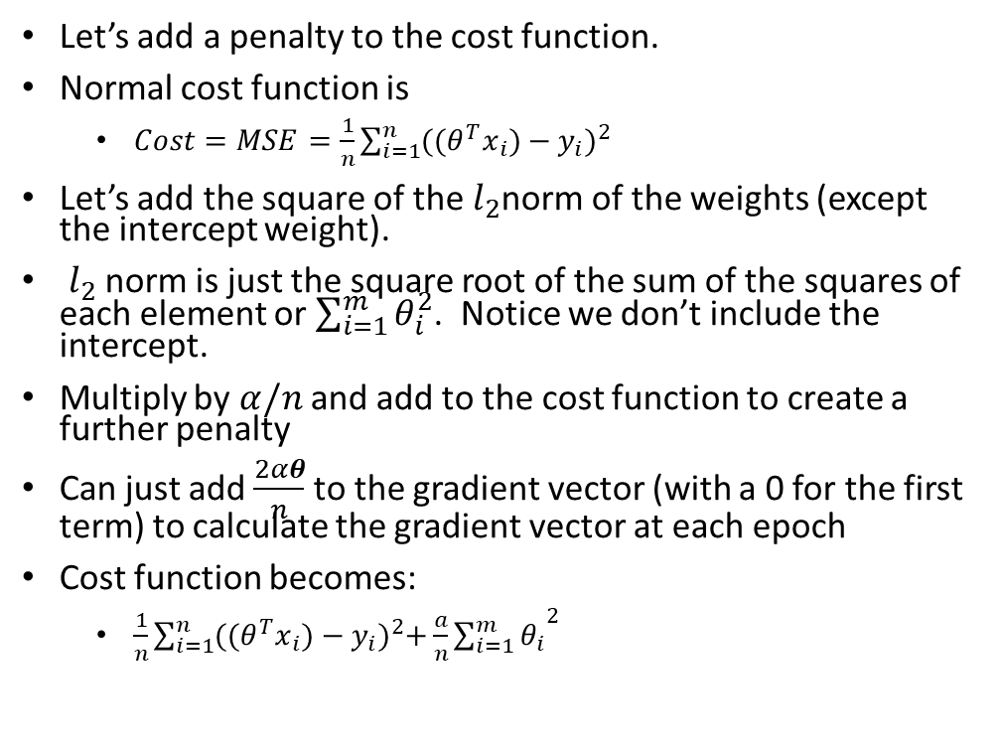
Ridge Regression
Let’s add a penalty to the cost function.
Normal cost function is
$Cost=MSE=\frac{1}{n}\sum_{i=1}^{n}{{((θ^{T}x_{i})−y_{i})}^{2} }$
Let’s add the square of the $l_{2}$norm of the weights (except the intercept weight).
$l_{2}$ norm is just the square root of the sum of the squares of each element or $\sum_{i=1}^{m}{θ_{i}^{2}}$. Notice we don’t include the intercept.
Multiply by $α/n$ and add to the cost function to create a further penalty
Can just add $\frac{2αθ}{n}$ to the gradient vector (with a 0 for the first term) to calculate the gradient vector at each epoch
Cost function becomes:
$\frac{1}{n}\sum_{i=1}^{n}{{((θ^{T}x_{i})−y_{i})}^{2}+{\frac{a}{n}\sum_{i=1}^{m}{θ_{i}}}^{2}}$

Slide 6
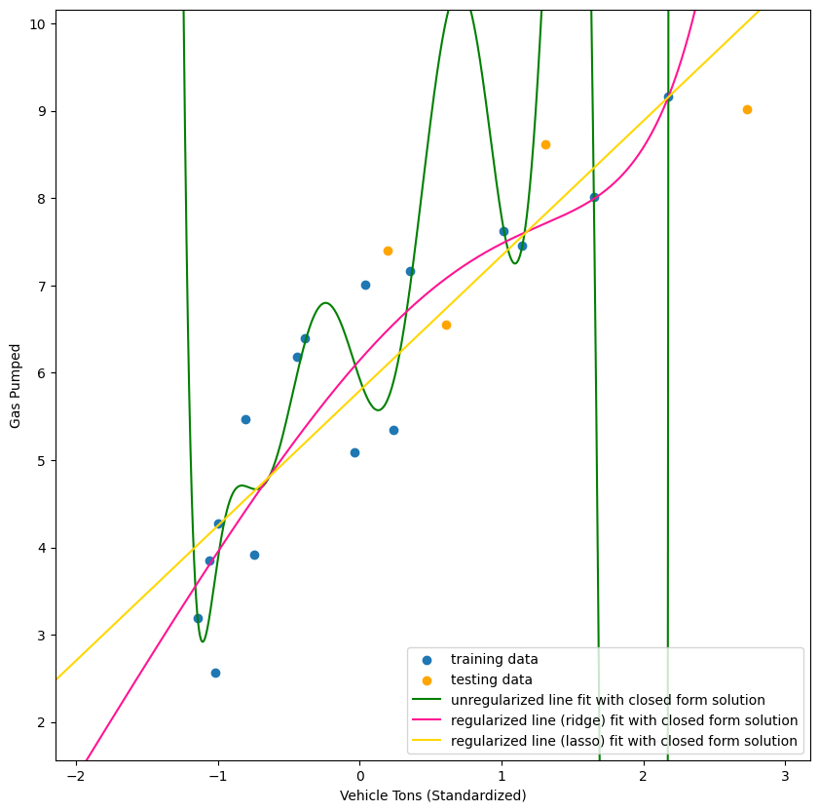
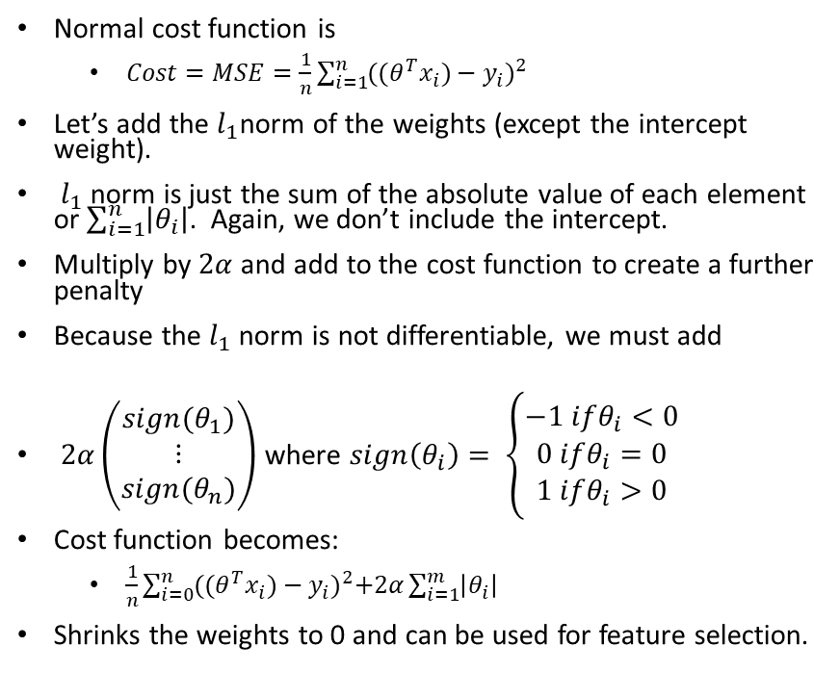
Lasso Regression
Normal cost function is
$Cost=MSE=\frac{1}{n}\sum_{i=1}^{n}{{((θ^{T}x_{i})−y_{i})}^{2} }$
Let’s add the $l_{1}$norm of the weights (except the intercept weight).
$l_{1}$ norm is just the sum of the absolute value of each element or $\sum_{i=1}^{n}{\left|θ_{i}\right|}$. Again, we don’t include the intercept.
Multiply by $2α$ and add to the cost function to create a further penalty
Because the $l_{1}$ norm is not differentiable, we must add
$2α\left(\begin{matrix}sign(θ_{1}) \\ ⋮ \\ sign(θ_{n})\end{matrix}\right)$ where $sign\left(θ_{i}\right)= \left\{\begin{matrix}−1 ifθ_{i}<0 \\ 0 ifθ_{i}=0 \\ 1 ifθ_{i}>0\end{matrix}\right.$
Cost function becomes:
$\frac{1}{n}\sum_{i=0}^{n}{{((θ^{T}x_{i})−y_{i})}^{2}+2α\sum_{i=1}^{m}{\left|θ_{i}\right|}}$
Shrinks the weights to 0 and can be used for feature selection.

Slide 7
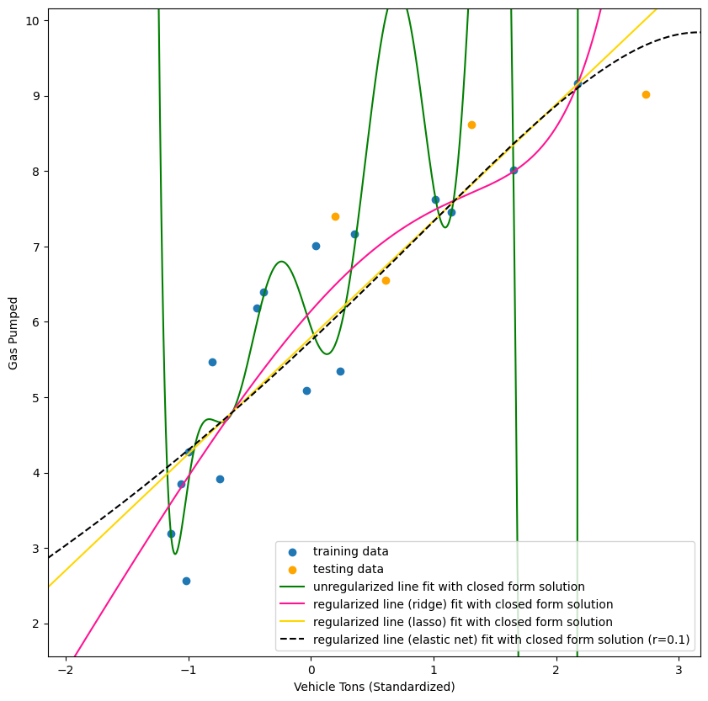

Elastic Net Regression
Just a combination of ridge and lasso regression
Use r to weight the ridge or lasso penalty. Closer to 1 means lasso and closer to 0 means ridge
$\frac{1}{n}\sum_{i=0}^{n}{{((θ^{T}x_{i})−y_{i})}^{2}+r(2α\sum_{i=1}^{m}{\left|θ_{i}\right|)+(1−r)({\frac{a}{n}\sum_{i=1}^{m}{θ_{i}}}^{2})}}$

Slide 8
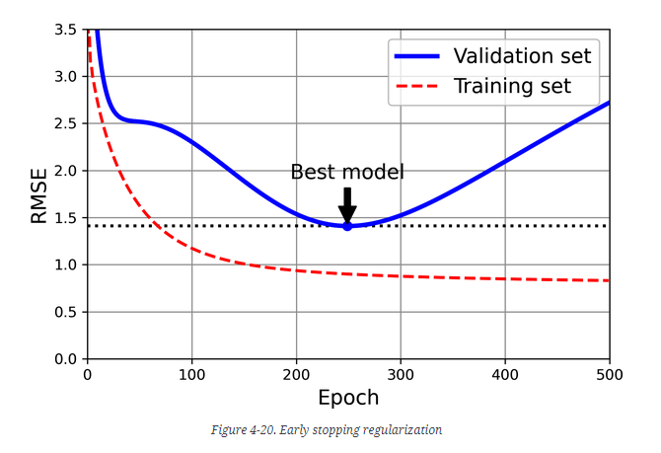
Early Stopping
Split train data into train and validation.
Fit a model at each epoch and calculate the error on the validation data.
Pick the weights of the model at the point before overfitting and where the validation error is the lowest.
From “Hands-On Machine Learning with Scikit-Learn, Keras, and TensorFlow, 3rd Edition”

